Slide 1


Analyzing Agricultural Productivity Across Indian States
Presented By:
Student Name : Kamineni Dharmendra Balaji
College Name & Department : Aditya College Of Engineering Madanapalli
Amd Artificial Intelligence & Data Science
Student Registration ID : STU662fa177912581714397559

Slide 2

Learning Objectives
Overview: Understand regional disparities in Indian agricultural productivity
Data Analysis: Analyze key metrics: yield, input costs, technology adoption.
State-Specific Insights: Examine high & low productivity states such as
Punjab and Bihar.
Policy Implications: Evaluate the impact of policies, subsidies, and
infrastructure.
Sustainable Practices: Explore eco-friendly methods that enhance
agricultural output.
GOAL
Source :
www.freepik.com/

Slide 3
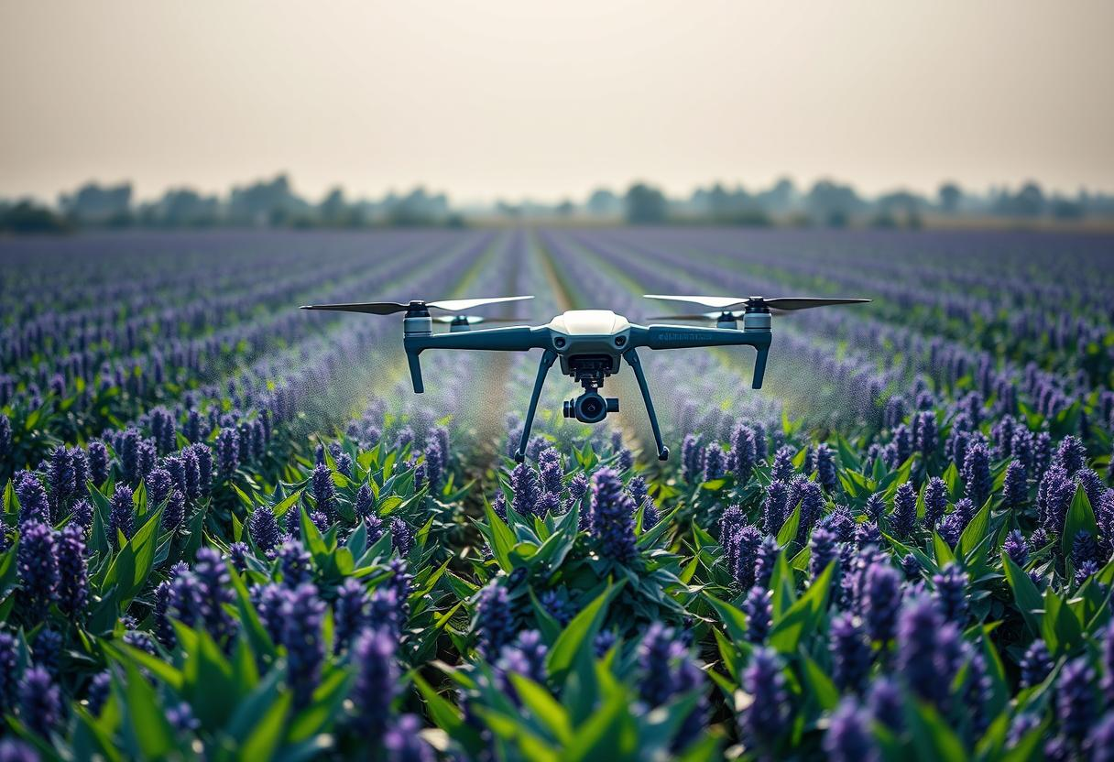
Tools and Technology used
India's agriculture varies greatly by state, with Punjab leading wheat yield at 5.15 tons/ha.
Tamil Nadu excels in rice yield at 6.9 tons/ha, Bihar trails in wheat at 2.9 tons/ha.
Technology adoption differs: Punjab uses drones for pesticide spraying, lowering chemical use by 20%.
Andhra Pradesh adopts drip irrigation, boosting yields by 15%, while Bihar relies on traditional methods.
Government schemes like PMKSY and Soil Health Card improve irrigation and fertilizer efficiency.
Challenges include small farms, water scarcity, and limited farmer education on modern tech.
Future focus: technology spread, sustainable farming, and supportive policies.

Slide 4

Methodology
Data Sources: Combining Ministry of Agriculture, NSSO, and state data from 2015-2024.
Productivity Metrics: Yield, Total Factor Productivity (TFP), and output value per worker
measured.
Methodological Framework: Normalization, crop weighting by economic value, and
composite index creation.
Spatial & Econometric Analysis: GIS mapping, Moran’s I for clustering, regression, and
panel data modeling.
Robustness Checks: Sensitivity analysis and comparison with DEA and SFA methods.

Slide 5
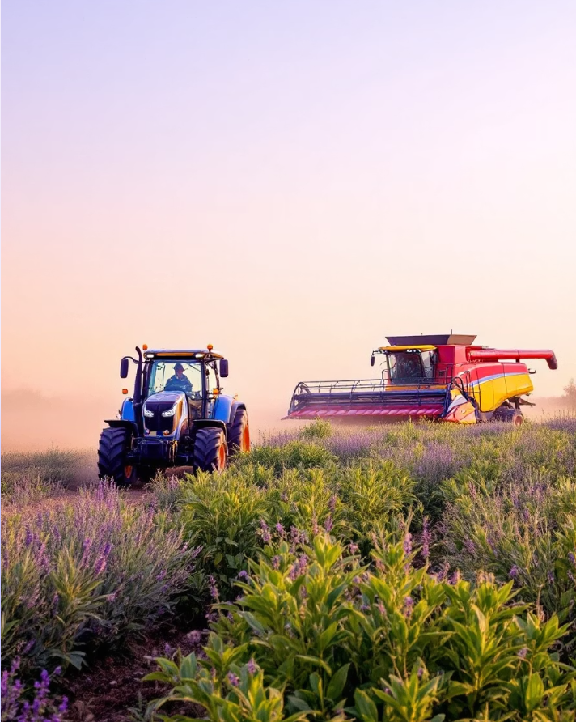
Problem Statement:
Yield Variations: Significant differences in crop yields like rice and wheat between states
such as Punjab and Bihar.
Resource Inequality: Uneven access to irrigation, quality seeds, and technology; 70% of
farmers are marginal.
Climate Vulnerability: Climate impacts like droughts and floods severely affect 65% rain-
fed agriculture.
Market Access Issues: Poor infrastructure limits selling options; less than 2% of produce
reaches organized retail.
Need for Targeted Interventions: State-specific policies are vital to sustainably boost
productivity and farmer incomes.
Average farmer income remains low, around $1500 USD per year.

Slide 6

Solution:
The challenge: wide productivity gaps, exemplified by Punjab and Bihar.
Punjab: 99% irrigated, high fertilizer (240 kg/ha), rice yield ~4 tons/ha.
Bihar: 60% unirrigated, low fertilizer (110 kg/ha), rice yield ~1.5 tons/ha.
Integrated Agricultural Enhancement Program (IAEP):
Boost irrigation—target 20% increase in 5 years using drip, sprinkler systems.
Improve soil health via testing and balanced fertilizers, aiming 30% efficiency gain.
Promote subsidized climate-resilient HYV seed adoption to 75% farmers.
Deploy precision farming tech to reach 50% of farmers with digital aid.
Train 1 million farmers annually on modern practices and water conservation.
Expected results include 30% productivity rise, better incomes, and sustainable farming.

Slide 7
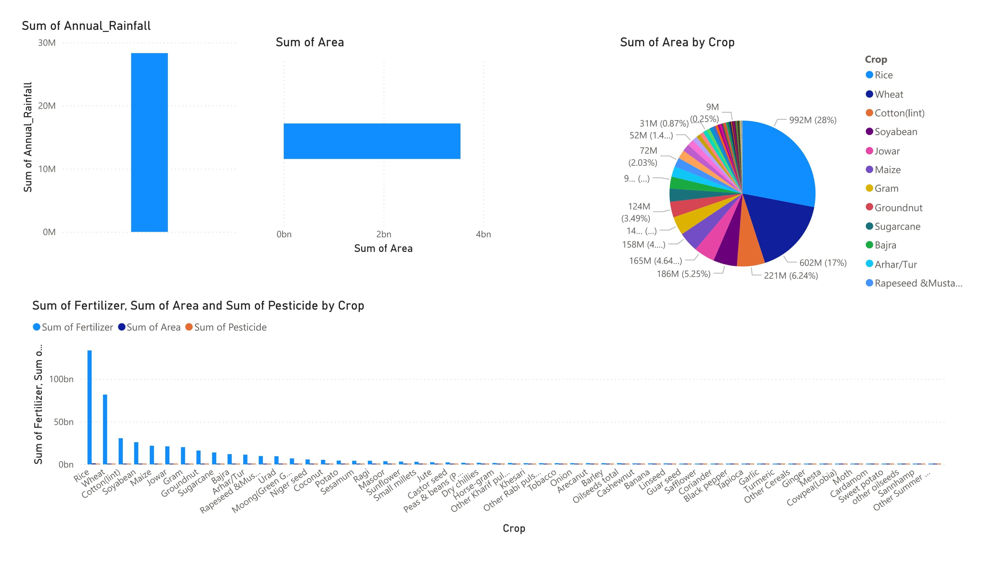
Screenshot of Output:

Slide 8
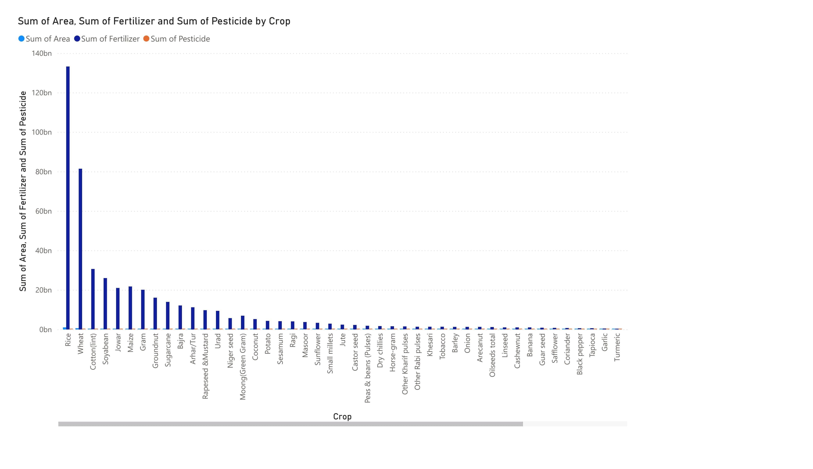

Slide 9
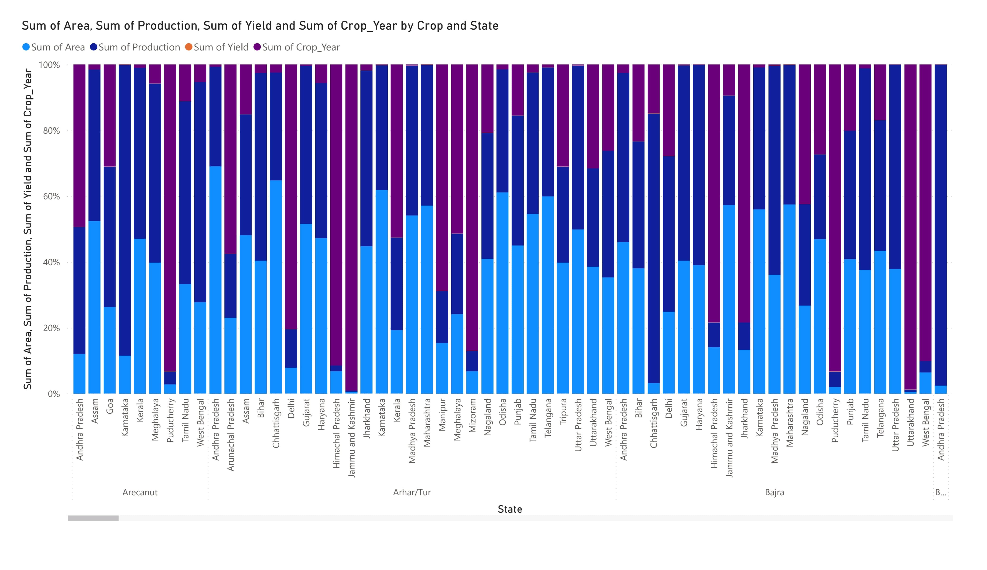

Slide 10
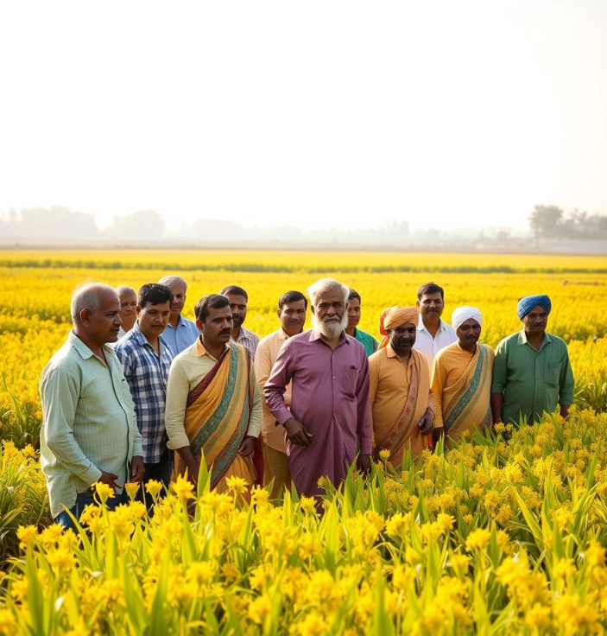
Conclusion:
Losing the productivity gap ensures India's food security.
Strategies must suit each state's unique challenges and needs.
Sustainable practices will drive long-term agricultural growth.
GITHUB REPOSITORY LINK:
https://github.com/KDharmendraBalaji/Analyzing-Agricultural-Productivity-Across-Indian-States

